Slide 1
Transaction Data Analysis and customer loyalty score prediction
Xiaochen Jin
2019/08/22

Slide 2
Background
Customer loyalty has long been an issue that attract credit card companies’ attention
it is much more costly to attract new customers
Features relate with customer loyalty
Challenge of maintaining loyal customers
Issue for multiple card holders
Low switching cost and 0% balance transfer

Slide 3
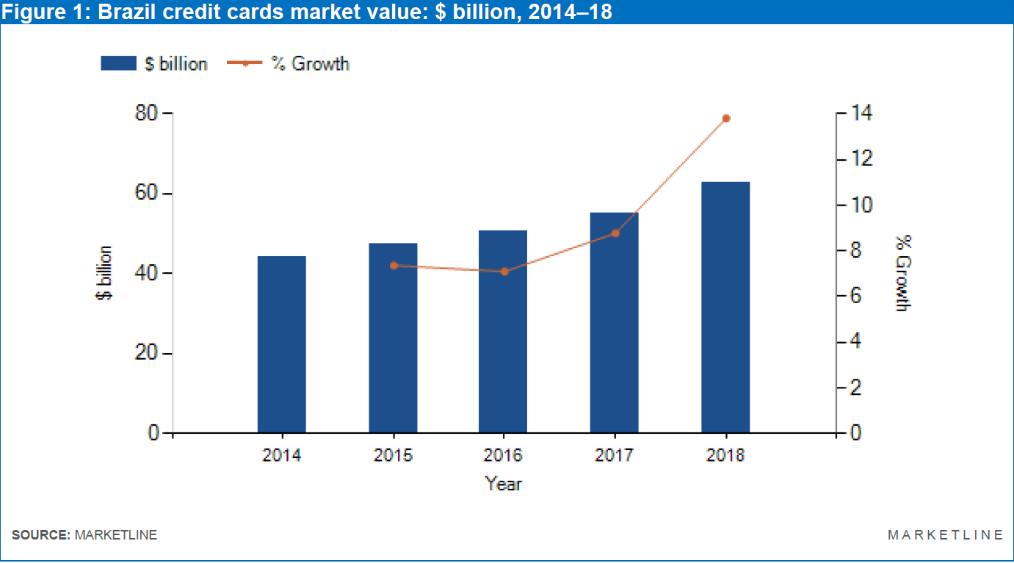
Credit Card Industry in Brazil
Market is expanding
Continue to grow in 5 years
Expect to reach 94.1 billion dollars in 2023
Elo as an emerging competitor in this market, also expects to expand its own share of profit

Slide 4
Data Overview
Data is constructed by five files in total:
Training data:
Target value, basic credit card information
Historical transaction data:
Transaction history in the past 13 months
More recent transaction history data:
Transaction history in the past 2 months
Merchant information data:
Various detailed information related with merchants
Test data:
Same features as training data expect target is removed

Slide 5
Data exploration
How big is the dataset?
The largest data file among the five ones is historical transaction data, which includes 29,112,361 lines of records (2.65G in size). There are 325,540 unique credit card ID and 326,312 unique merchandize ID in historical transaction data file.
Train vs Test
Train and test file share very similar distribution in their variables such as card activation date and censored features

Slide 6
Data Aggregation
File Combination
Feature Creation and Aggregation
Mapping this aggregated data set back to train file according to card ID

Slide 7
Data Aggregation
First is the file combination.
Join train data, merchant data and two transaction data files together based on card ID in train set
Second is feature creation and aggregation.
In the process of joining, data such as transaction records need to be aggregated in the level of card ID
Methods such as sum, mean, standard deviation were applied to numerical variables
Categorical variables are processed by calculating summarized statistical values on number of occurrence for each level
The third step was mapping this aggregated data set back to train file according to card ID.
The final data set ended up with 137 variables in total

Slide 8
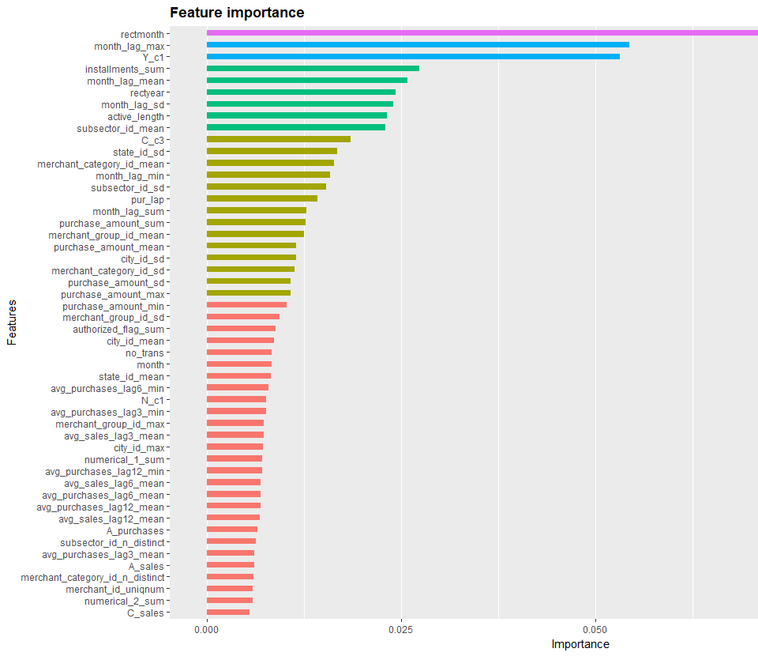
Feature Importance
Generated feature importance graph from XGBoost model
The most important features are most recent purchase month, maximum number of month lag between transactions, and number of Yes in category_1

Slide 9
Feature Importance
Simple linear regression results
 | Estimate | Standard Error | t-value | P-value
Authorized_flag_sum | 1.728485e-02 | 3.326174e-03 | 5.196616 | 2.056133e-07
Y_C1 | -3.531188e-02 | 7.336123e-03 | -4.813425 | 1.498128e-06
N_C1 | -3.287560e-02 | 7.496519e-03 | -4.385448 | 1.165364e-05
Avg_pur_lap | 2.980557e-02 | 8.531616e-03 | 3.493544 | 4.780305e-04
Month_lag_sd | -2.626114e-01 | 7.870639e-02 | -3.336596 | 8.501741e-04
Month_lag_max | -4.156970e-01 | 1.263291e-01 | -3.290588 | 1.002093e-03
Month_lag_mean | -1.079141e-01 | 3.484160e-02 | -3.097277 | 1.956681e-03
Merchant_category_id_max | -2.104776e-03 | 7.371669e-04 | -2.855223 | 4.306572e-03
Merchant_category_id_min | 1.361909e-03 | 5.445392e-04 | 2.501030 | 1.239385e-02
Merchant_category_id_sd | 2.573909e-03 | 1.083403e-03 | 2.375763 | 1.752522e-02
State_id_mean | 2.027150e-02 | 9.027418e-03 | 2.245548 | 2.474748e-02
A_c3 | 5.745411e-02 | 2.728081e-02 | 2.106027 | 3.521863e-02
Category_1_uniqnum | -2.344199e-01 | 1.132406e-01 | -2.070105 | 3.845962e-02
Merchant_group_id_max | -4.510188e-06 | 2.194619e-06 | -2.055112 | 3.988550e-02
Merchant_group_id_sd | 1.233493e-05 | 6.253304e-06 | 1.972546 | 4.856569e-02

Slide 10
Feature Selection
Non-informative predictors removal
Multicollinearity Issue

Slide 11
Feature Selection: Non-informative predictors removal
Non-informative predictors refers to predictors with low variation and limited ability in offering new information
Two criteria:
Frequency of the most frequent unique value over the total occurrence
The ratio between most frequent value and second frequent value in one variable
Predictors are considered non-informative if the most frequent value occurred more than 70% of the total times and 20 times more frequent than the second frequent value

Slide 12
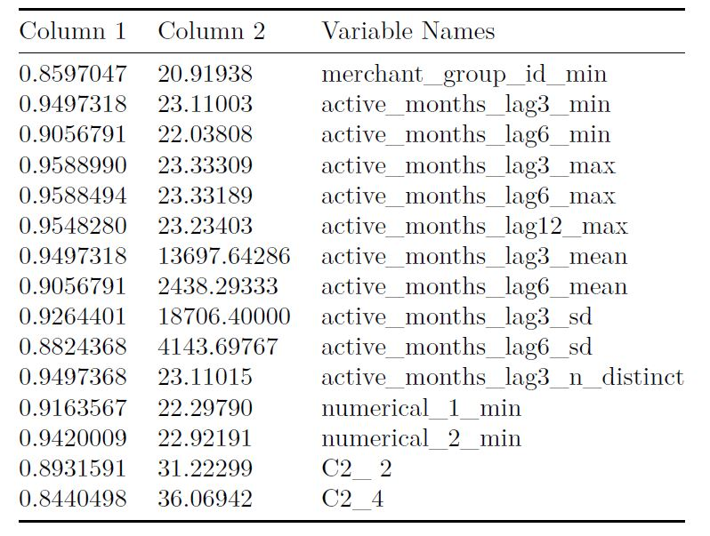
Selected Non-informative Features
Column 1 represents the rate of occurrence of the most frequent value in each feature
Column 2 represents the ratio between most frequent value and second most frequent value in each feature

Slide 13
Feature Selection: Multicollinearity Issues
Multicollinearity refers to the issue that predictors are correlated with each other, which affects their ability in predicting the target value
I used the following algorithm provided by Kuhn and Johnson (2013) to remove predictors with multicollinearity issue :
1. Calculate the pairwise correlation matrix of the predictors.
2. Determine the two variables (A and B) that has the largest absolute pairwise correlation.
3. Calculate the average correlation between variable A and other variables, repeat the same process with variable B.
4. Compare the average correlation value for A and B, remove the predictor with larger correlation.
5. Repeat steps 2-4 until no absolute correlation is above the threshold.
Set threshold as 0.8, 29 variables are considered having multicollinearity

Slide 14
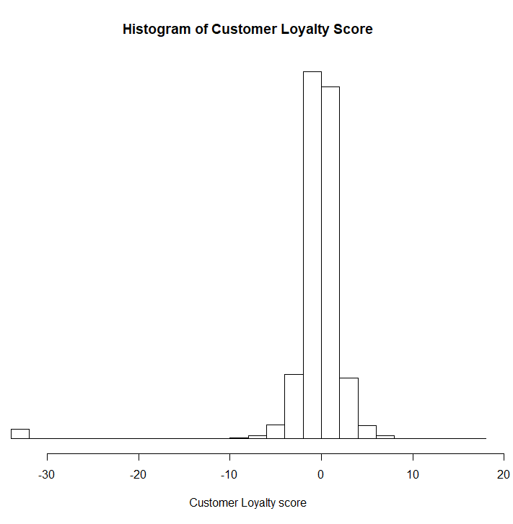
Distribution of Target value
The distribution of target follows a gaussian like distribution
With center around 0 and standard deviation 3.85
It has a long left tail with minimum number as -33.21928
Which determines the analysis plan of building separate models for outlier target values

Slide 15
Analysis Plan Determination
Adding feature inspired from Kaggle kernel
Average monthly purchase amount ratio
By aggregating transactions for each card by month, then calculating purchase amount ratio across months and averaging the results by card in the end.
Three sets of cross validation
5 times 80% data partition
5 folds cross validation
10 folds cross validation
Three sets of training data
Full set with all features (138 features)
Without non-informative features (123 features)
Without non-informative and multicollinear features (94 features)
Build separate models for outlier values and create ensemble prediction with signed weight

Slide 16
Method
Parametric method:
GLM with elastic net
Ridge Regression
Non-parametric method:
Random Forest
Extreme Gradient Boosting

Slide 17
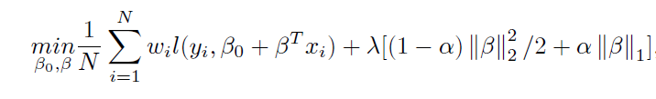
Parametric method: GLM with elastic net
Basic Formula(Hastie and Qian, 2014):
Hyperparameter tuning selection:
α grid search 10 values from 0.3 or 0.7
λ grid search 10 values from 0.001 to 0.01

Slide 18
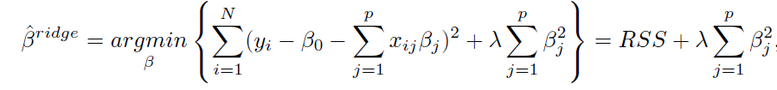
Parametric method: Ridge regression
Basic Formula (James et al., 2013):
Hyperparameter tuning selection
Set α to 0
λ grid search 20 values from 0 to 0.2
Notes:
We calculated the coefficients of ridge regression from minimizing the penalized least square error. Lambda is a tuning parameter that controls shrinkage penalty.

Slide 19
Nonparametric method: Random Forest
Advantage of using Random Forest
Basic algorithm(Hastie et al., 2009):
For decision tree b from 1 to B:
a. Create bootstrap sample Z* of size N from training set
b. Build decision tree Tb on each set of bootstrap samples by repeating the following steps until minimum size of terminal node nmin is reached:
Select m number of features at random from p features
Split the best split-point from m into two nodes
Output the ensemble tree {Tb}B1

Slide 20
Hyperparameter selection
number of variables that randomly selected in each split (m)
minimum size of terminal node (nmin)
total number of trees in the ensemble (B)
m from 20 to 40
nmin equals 5
B equals 500
Parallelization

Slide 21
Nonparametric Method: XGBoost
Basic Algorithm for boosting (James et.al., 2013):
Set initial prediction of Y as F0, which equals the value that minimize the loss function residual defines as yi − f0(x)
For m from 1 to M:
a. For i from 1 to N:
i. Fit tree model hm on residuals and get new prediction fm = fm−1 + hm
ii. Compute updated residuals yi − fm(x)
Repeat the previous steps until the residual yi − fm(x) stop decreasing
Gradient boosting

Slide 22
Nonparametric Method: XGBoost
Hyperparameter tuning selection:
Optimal number of iterations M equals 1000
learning rate η equaled to 0.01, which is small enough to balance iteration number
L1 regulation parameter α equaled 0
L2 regulation parameter λ equaled 0 or 5
minimum split loss gamma was 0 or 1
maximum depth of each tree was grid searched from 5, 15, 25 levels
minimum child weight is controlled as 5 or 10
80% of the total number of training set were selected at random
70% of the column features were selected
60% of the column features were selected

Slide 23
Results
The result shows that the model with best performance is XGBoost
The performance between ridge regression and GLM were very similar with each other
There were slightly difference between different cross-validation splits
Model outliers separately did not improve the prediction accuracy
Most weight equals to 0, which means that only non-outlier predictions were used
Ensemble models had lower variance in RMSE for predictions

Slide 24
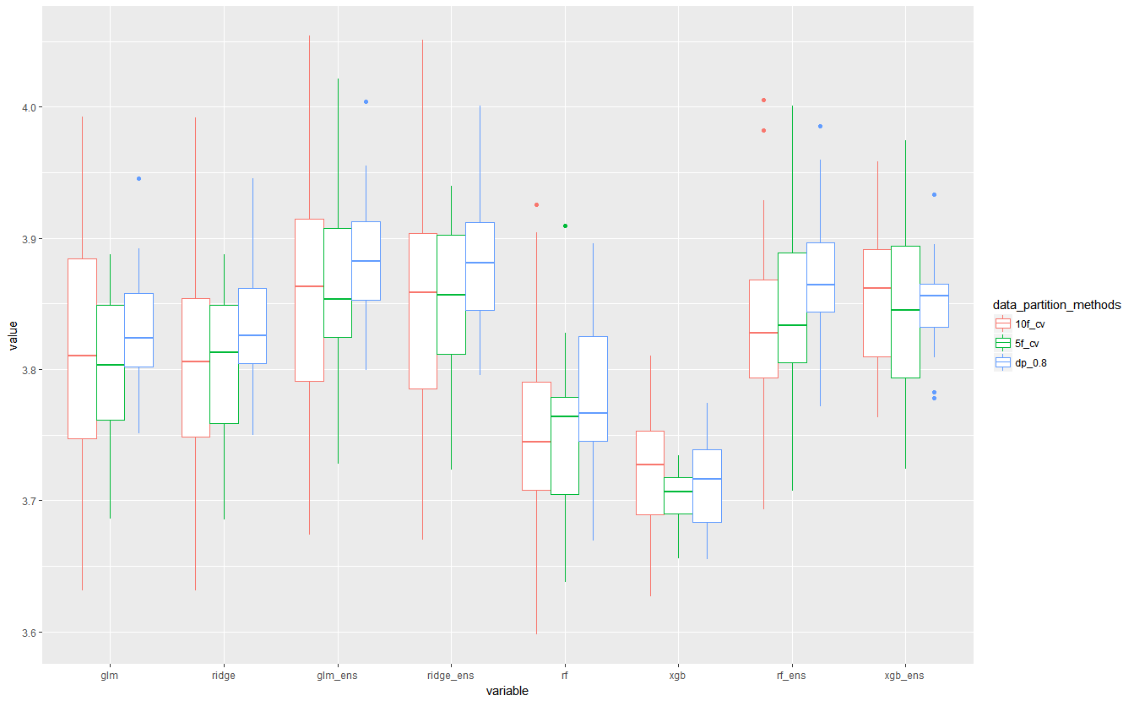

Slide 25
Censored data exploration
Censored numerical variables
Numerical 1 and Numerical 2 from Merchant dataset
Based on a kernel discussion, the author used genetic programming to transform values in the features to price like form
40% Values end with 99,00,50 and matches with real life expense in Brazil
Censored categorical variables
Three censored categorical variable in merchant data set and three in transaction data set
Focus on Category_1 and Category _3
Correlations were found between levels in the two categories
Notes:
Several Kaggle kernels have tried to investigate some of these anonymized predictors through optimization procedure such as genetic programming, from which they are able to retrieve the reversely transformed value.
It starts with initially generate random population of programs, and assign weights based on fitness. According to Koza and Poli (2003), genetic programming process iterates with making alternations on initial population through applying different genetic operations.

Slide 26
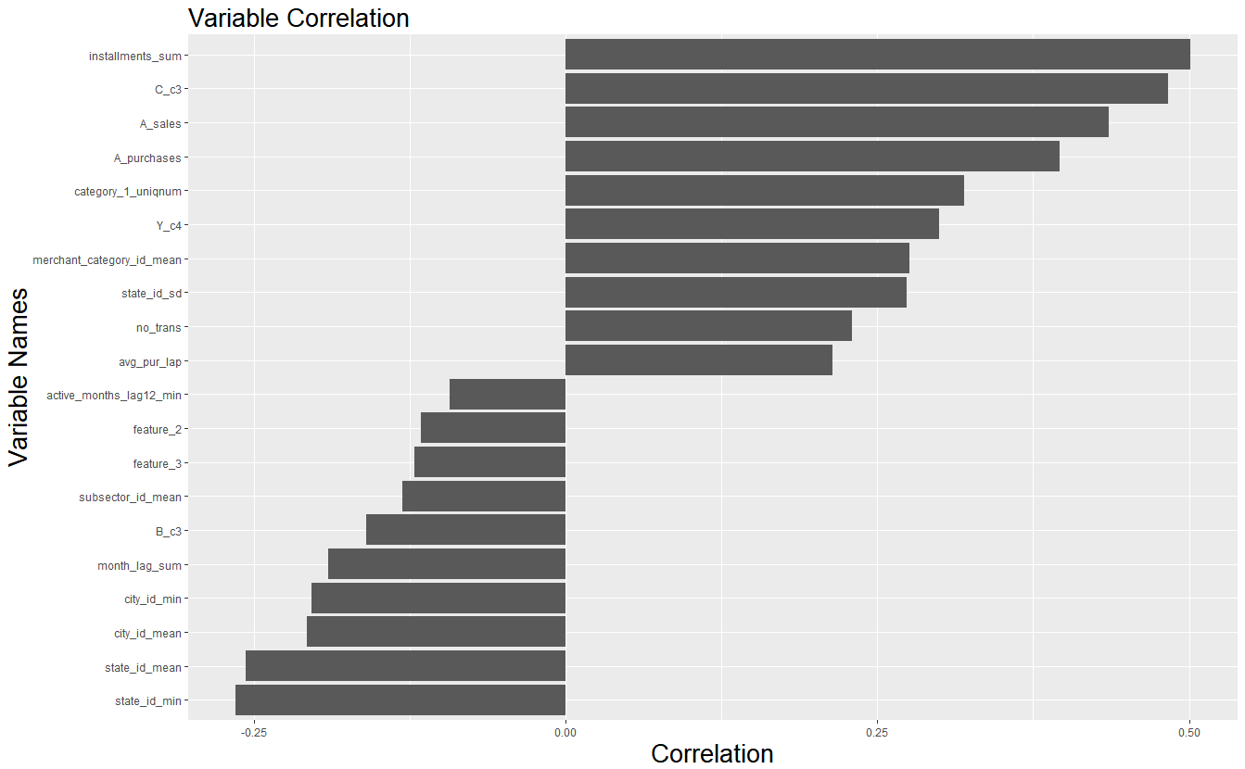
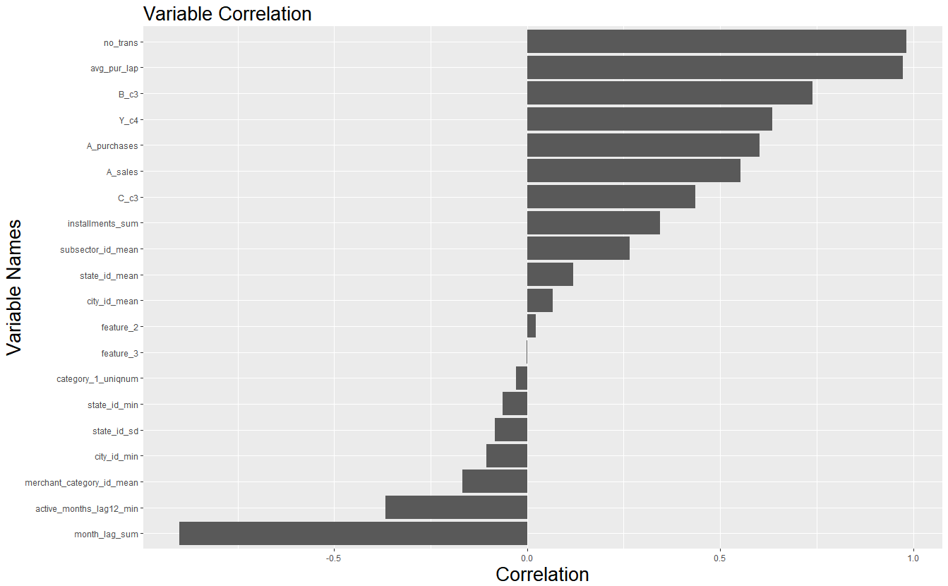
Category_1 yes and no
Notes:
From this pairwise correlation analysis, it was plausible for us to believe that category_1 related with customer behavior factors such as shopping frequency and variety. Both levels in category_1 related closely with number of purchases and installments, merchant which had sales profit last active month in A range, and quantity of transaction last month in A range.
Since level B in category_3 is most positively related with number of Nos in category_1, c Category_3 suggested to be a variable that measures number of transactions or number of approved transactions.

Slide 27
Limitations and future study suggestions
Feature selection process
PIMP with random Forest (Altmann et al, 2010)
Revision on outlier detection methods
More investigation on anonymous feature
Looking for similar data set
Matching data with more customer information to achieve more insights on customer behaviors
Notes:
PIMP represents permutation variable importance measurement.
This method is believed to correct feature importance measurement bias by comparing true importance with null importance distribution from fitting models on repeated permutation of target.

Slide 28
References
Altmann, A., Tolosi, L., Sander, O., Lengauer, T. (2010). Permutation importance: a corrected feature
importance measure, Bioinformatics, 26(10), 1340-1347.
Hastie, T., & Qian, J. (2014). Glmnet vignette. Retrieved from http://www.web.stanford.edu/~hastie/Papers/Glmnet_Vignette.pdf. Accessed September 20, 2016.
Hastie, T., Tibshirani, R., & Friedman, J. H. (2009). The elements of statistical learning: data mining, inference, and prediction. 2nd ed. New York: Springer.
James, G., Witten, D., Hastie, T., & Tibshirani, R. (2013). An introduction to statistical learning: With applications in R.
MarketLine Industry Profile: Credit Cards in Brazil. (2019). Credit Cards Industry Profile: Brazil, N.PAG. Retrieved from http://search.ebscohost.com.ezp2.lib.umn.edu/login.aspx?direct=true&AuthType=ip,uid&db=buh&AN=134988260&site=ehost-live

